Slide 1

Job portal management System
.Net Group
In-checked by Ma Htay Htay Hlaing, Ma May Myat Noe Oo, Ko Than Htike Aung

Slide 2
Group members
Mg Ye Htet Aung
Mg Myo Min Htay

Slide 3
PROJECT OVERVIEW
Job Portal Management systems are generally intends for job seekers who want to find the job that is suitable for them and companies who want to find qualified applicants .
For communication, we used Email system to reply job seekers and to receive information from companies.
Job Portal System can connect between employees and employers .It makes the recruitment process more smooth and less time consuming.
The structure of this website is simple and user-friendly.
The main purpose of Job portal website is to make job searching process and employee recruitment process much easier.

Slide 4
SYSTEM REQUIREMENTS
Software Requirements
Web browser like Internet Explorer, Mozilla Firefox, Microsoft Edge, Opera and Google Chrome.
Operating System
Any OS.

Slide 5
TWO MAJOR FUNCTIONS
Job seekers can find the job with by country, position, job nature and specialization. They can view, edit their profile and they can upload their resumes.
Companies can view and edit their account and they can create job posts. They can also manage jobs. They can view which appliers have applied their jobs.

Slide 6
TASKS PLANNING
YE HTET AUNG
Job seeker & Company CRUD
Job seeker & Company Sign in, forget password
Job offer CRUD
Graph
MYO MIN HTAY
Admin Sign in
Country, Skill, Position, Job Nature, Specialization CRUD
Job list, Job seeker list, Company list, Job offer list
COMMON(YE HTET AUNG & MYO MIN HTAY)
Email function
Design

Slide 7
AUTHORIZATION
There are two types of registering system for both employees and employers in job portal system.
Job seekers(Employees) need to sign up apply the job they want. They can't create job posts.
Companies(Employers) need to sign up to upload their job posts. Companies can’t apply the job.
Otherwise, as a guest, you can catalogue the jobs and view details of the job and company. But you can't apply the job.
Admin need to sign in to create basic needs of the job portal website and to see reports and to control job replying process.

Slide 8

MODULES
There are three modules in job portal management system.
Job Seeker module.
Company module.
Admin module.

Slide 9
JOB SEEKER MODULE
Job seeker registration.
Uploading resumes.
View details of their profile.
Edit their profile.
Applying multiple jobs.
View history of applied jobs.
Rejecting(Undo) their applied jobs.
Reset password.

Slide 10
COMPANY MODULE
Company registration.
View details of their profile.
Edit their profile.
Create job posts.
Edit and delete job posts.
View job report and job offer report.
View appliers detail.
Download resumes.
Accept and Reject the appliers.

Slide 11
CONT’D
Searching the job offer list with job title.
Filtering applier who is accepted or rejected.
Activate or deactivate the job posts.
Send Email to admin.
Reset password.

Slide 12
ADMIN MODULE
View total amount of job seekers, companies and jobs.
View weekly charts of job seekers and companies.
Create, Edit, Delete countries, job types, skills, positions, and specializations.
View job report, job seeker report, company report and job offer report.
Search job offer list by company name and job title.
Filtering appliers who is accepted and rejected.
Sending email to appliers who is accepted and rejected with specific company name and job title.

Slide 13
PROJECT DETAILS & SCREENSHOTS

Slide 14
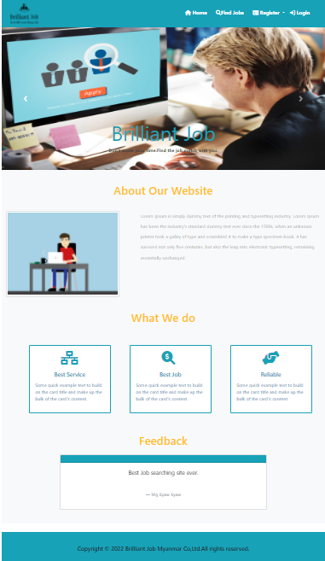
HOME PAGE
When you first enter our website, you will see our home page. You will see about our website, our services and feedbacks.

Slide 15
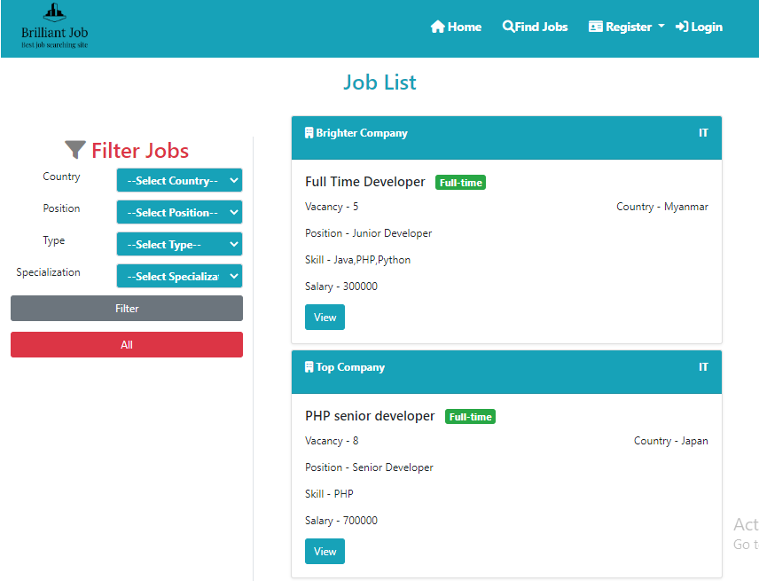
FIND JOB PAGE
Displaying all job posts. You can see detail of job post by clicking view button.
Users can search job posts by choosing dropdown list(country, position, type,
specialization) and filter with specific criteria.

Slide 16
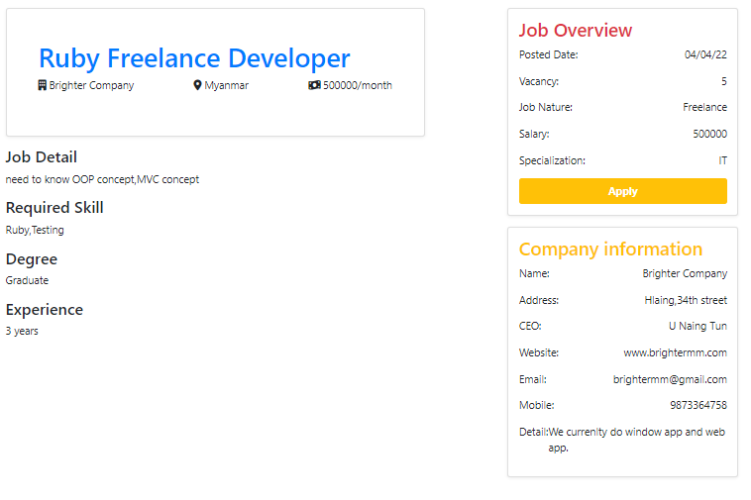
JOB DETAIL PAGE
Showing details of job and information about company of this job.

Slide 17
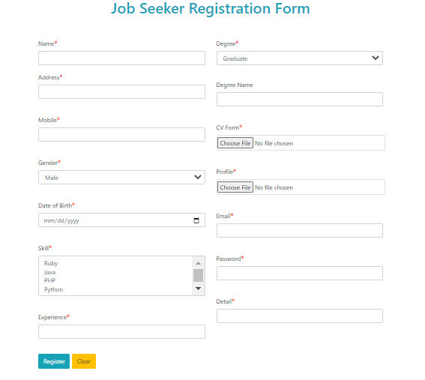
JOB SEEKER REGISTRATION
At this page, job seeker has to fill his profile and upload his resume.
He also need to fill email and password.

Slide 18
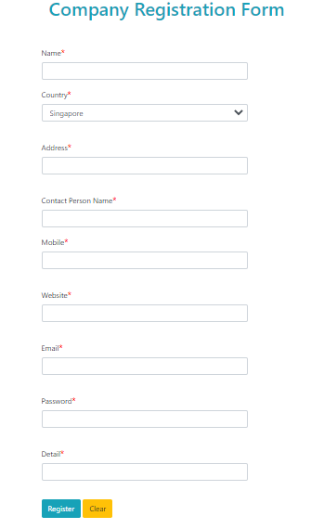
COMPANY REGISTRATION
At this page, companies has to fill their profile. They also need to fill email and password.

Slide 19
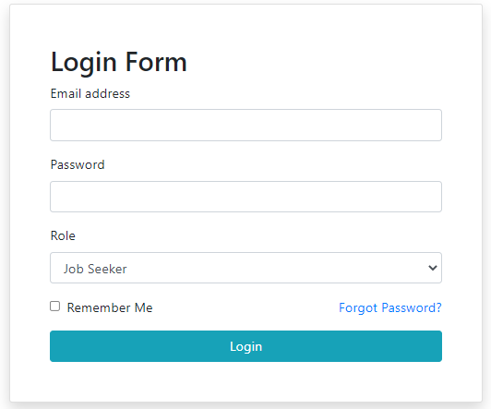
LOGIN FORM
At this page, users need to fill email and password to sign in.
Users has to choose which role before logging in.
They can reset their password through forgot password link.

Slide 20
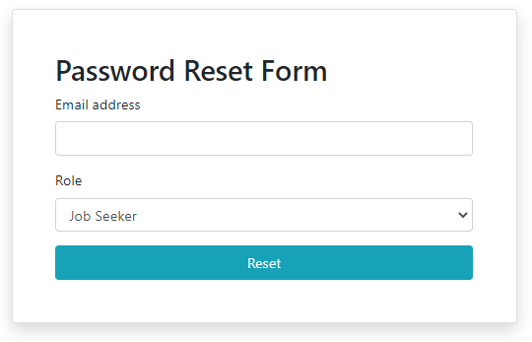
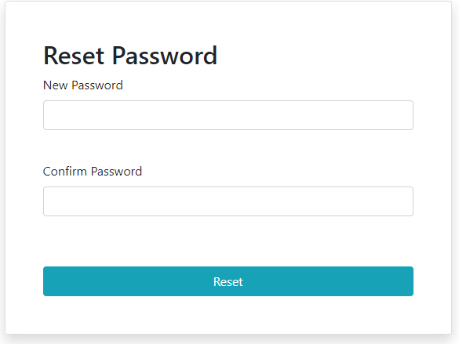
RESET PASSWORD FORM
At this page, users need to fill their email and choose their role to reset password.
Then, we send reset password page link to users by using email.
When you reach reset password page, you can reset your old password with new password.

Slide 21
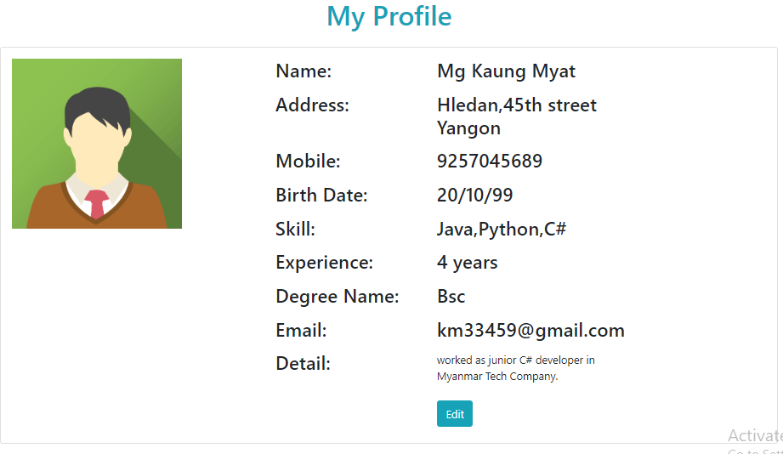
JOB SEEKER PROFILE
Job seekers can see and edit their profile detail at this page.

Slide 22
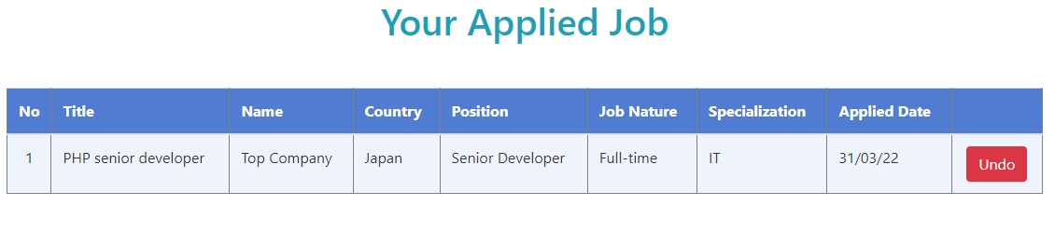
APPLIED JOB PAGE
Job seekers can view the history of applied jobs at this page .They can undo the jobs.

Slide 23
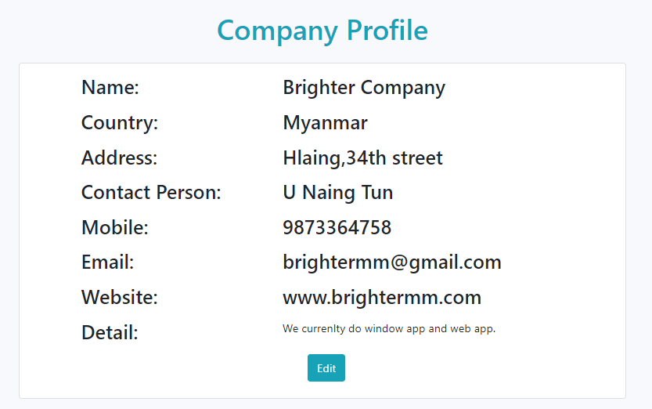
COMPANY PROFILE
Companies can see and edit their profile detail at this page.

Slide 24
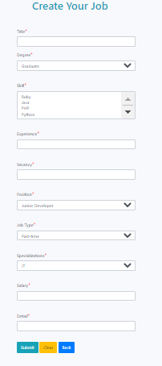
CREATE JOB PAGE
At this page, companies can create their job posts.

Slide 25
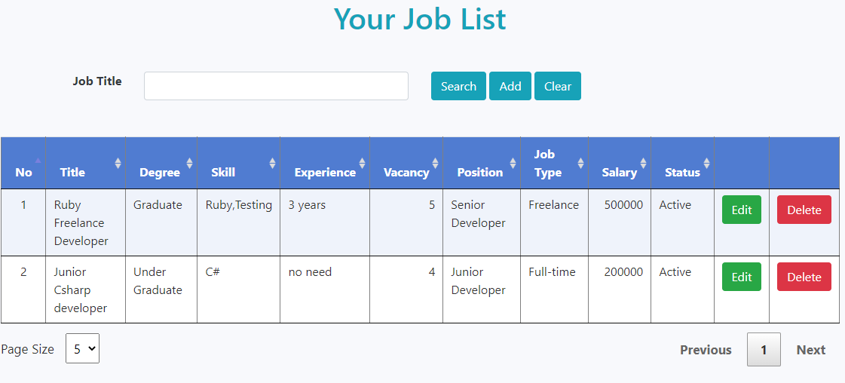
JOB LIST PAGE
At job list page, companies can view, edit and delete their job posts. They can also search job posts by job title.

Slide 26
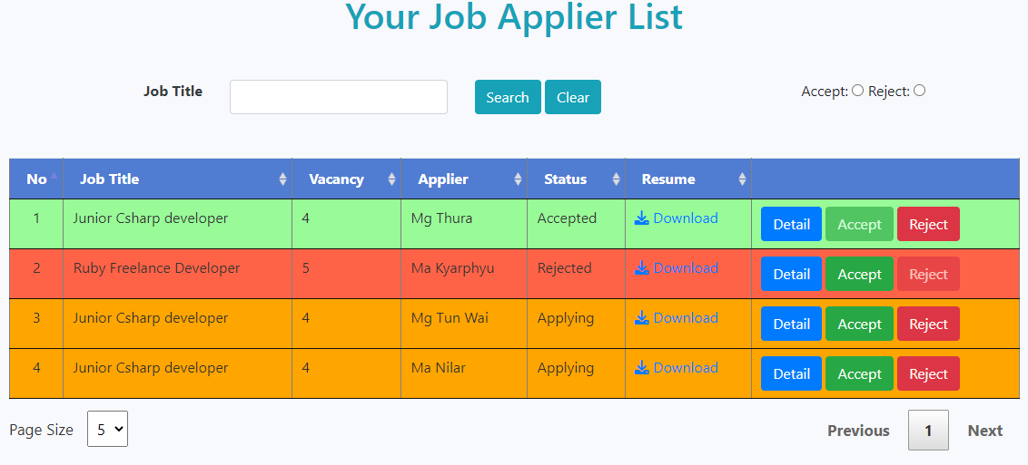
JOB APPLIER LIST PAGE
At job applier list page, companies can not only view detail of their applicants but also download their resumes. They can accept or reject the appliers. They can also search with accept or reject button by job title.

Slide 27
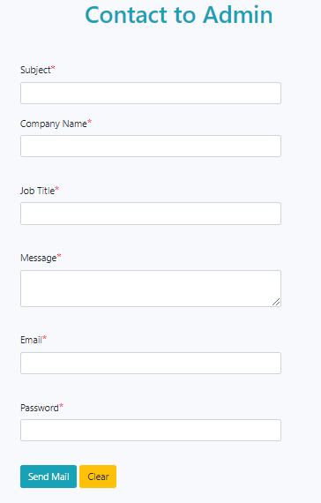
CONTACT TO ADMIN
Companies can send email to admin at this page.

Slide 28
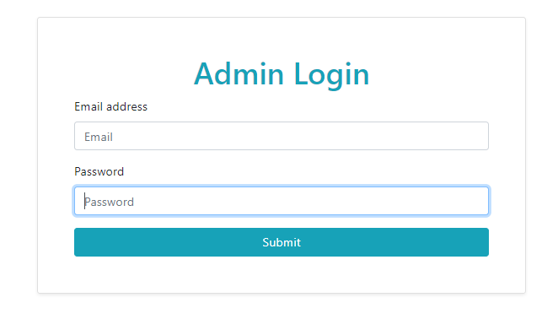
ADMIN LOGIN FORM

Slide 29
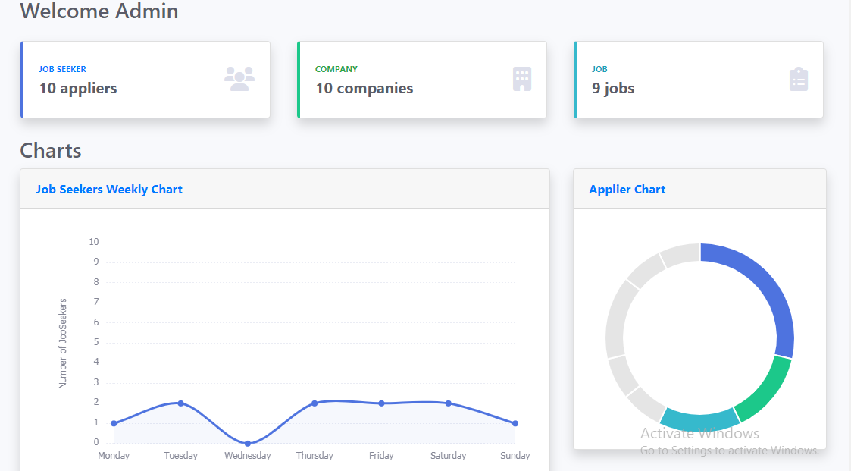
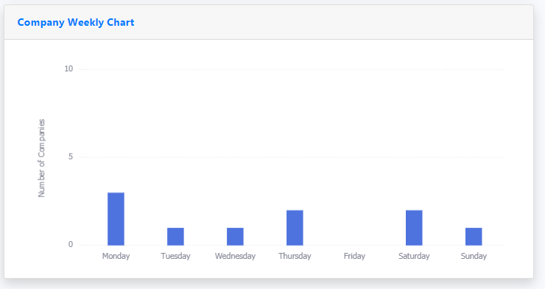
ADMIN HOME

Slide 30
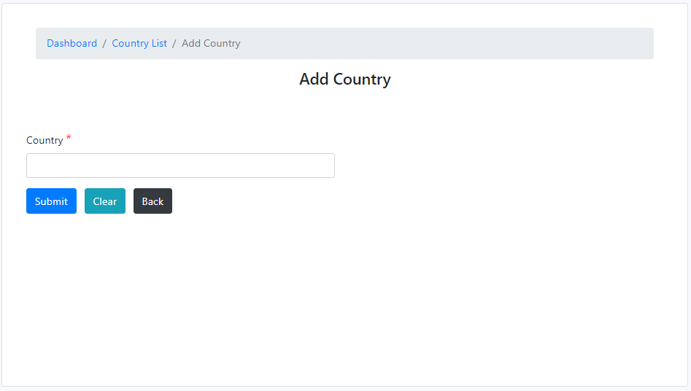
ADMIN MANAGEMENT
Admin can create country at this page.
Admin can also create position, job type, skill and specialization like this page.

Slide 31
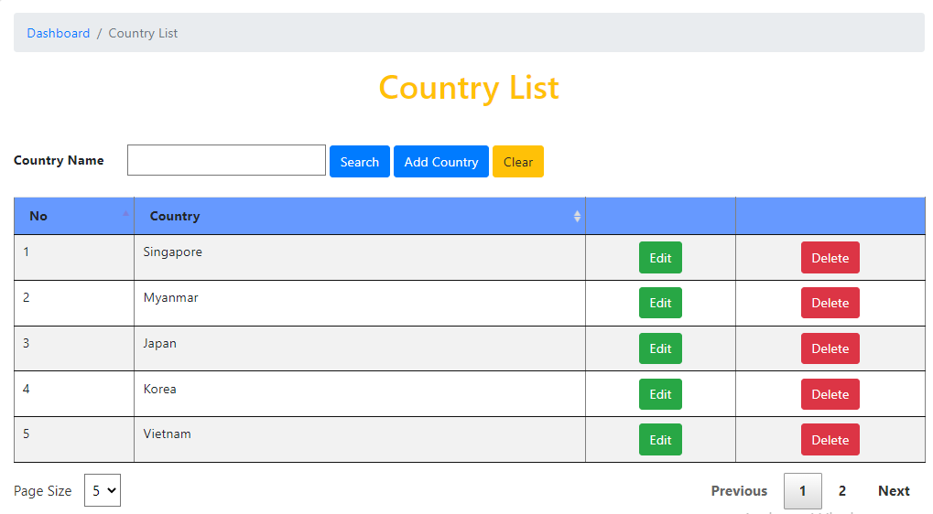
ADMIN REPORT
Admin can view, edit and delete country list at this page.
Admin can view , edit and delete position, job type, skill and specialization lists like this page. Admin can also search by specific name.

Slide 32
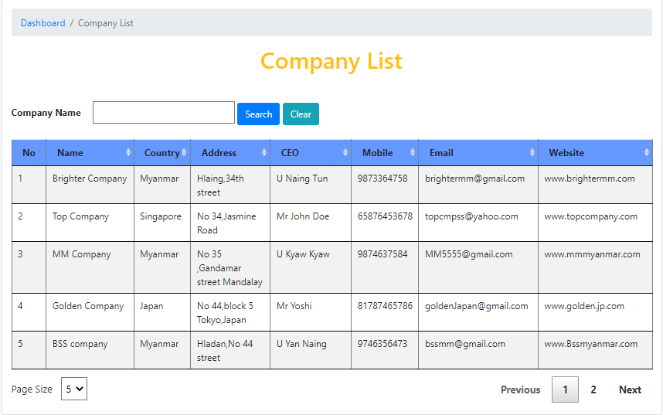
COMPANY REPORT
Admin can view company list at this page. Admin can also search companies by company name.

Slide 33
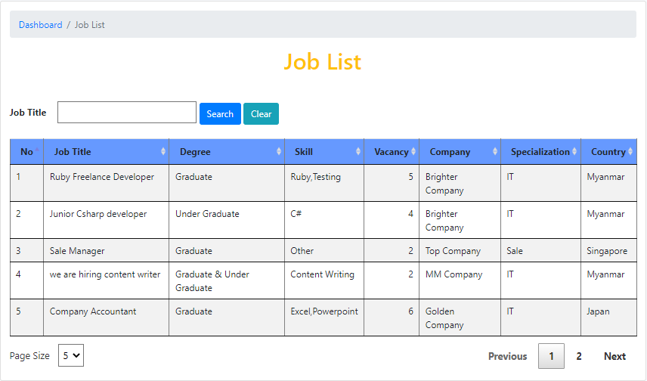
JOB REPORT
Admin can view job list at this page. Admin can also search jobs by job title.

Slide 34
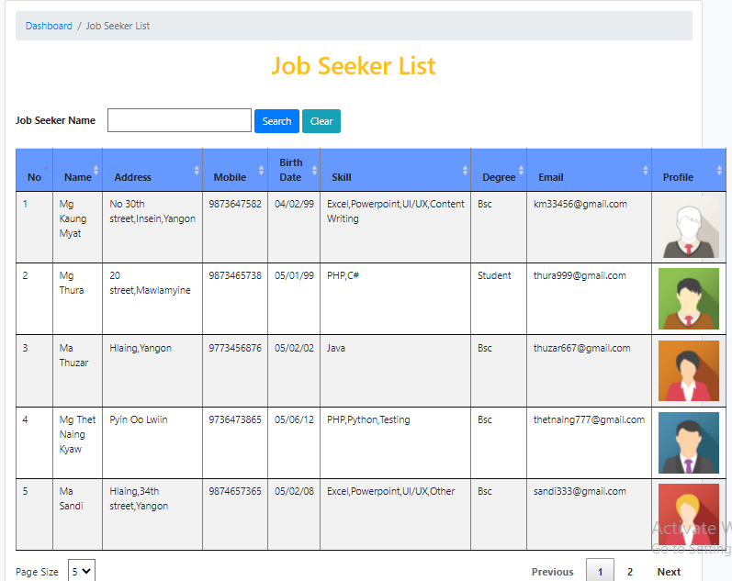
JOB SEEKER REPORT
Admin can view job seeker list at this page. Admin can also search job seekers by job seeker name.

Slide 35
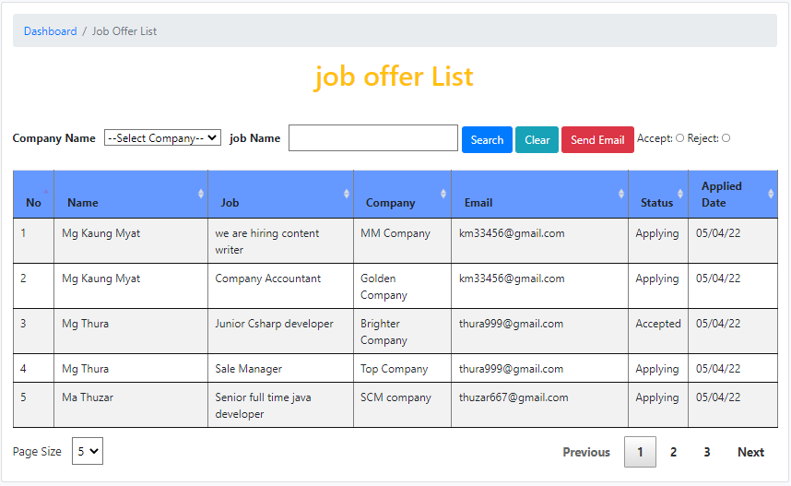
JOB OFFER REPORT
Admin can view job offer list at this page. Admin can also search job seekers by job title, company name with accept or reject.
Admin will send email to the appliers who is accepted or rejected with specific company name and job title.

Slide 36
SKILLS LEARNED
Technical skills (Hard skills)
Soft skills

Slide 37
TECHNICAL SKILLS(HARD SKILLS)
Coding abilities
Error debugging skills
Framework thinking skills(three-layer architecture)
Programming learning skills(self-study)
Version control system knowledge
Code refactor
Environment setup

Slide 38
SOFT SKILLS
Creative thinking skill
Problem solving skill
Communication skill
Teamwork
Time management
Multitasking
Responsibility
Flexibility
Social skills
Leadership skills

Slide 39
CONCLUSIONS
We are trained as OJT members in BIB-OJT-Batch(2) for four months from 27-12-2021 to 7-4-2022.We have learned front-end design(HTML, CSS, JQuery) for two months and back-end(C#, ASP.Net) for two months. Our mentors trained us with a great patience during these months. If we had a problem about coding, they explained us carefully and clearly. We have got knowledge about work experiences from this training. This OJT training was the turning point of our life. From suggestion of our mentors, we knew how to continue our programming learning journey.
Special thanks to trainers and OJT members!

Slide 40


